Slide 1

Indian Traditional Knowledge
18LEM109T
Dr. S.Ramya
Dept. of EFL
SRM IST

Slide 2
Today’s session
Introduction
Course Learning Rationale
Course Learning Outcome
Syllabus - Lesson Plan
Modules
Assessments
Discussions

Slide 3
Introduction
15 hours
0 credit
Fully internals
Mandatory course
Weekly one hour
5 Modules – each module has 3 sessions

Slide 4
Course Rationale
To introduce the learners to the early and traditional environmental friendly agricultural practices
To enable the students to recognize and appreciate the contribution of India to astronomical studies
To draw the learner’s attention towards the holistic approach behind Indian system of medicine

Slide 5
Contd…,
To cultivate a sense of appreciation about ancient Indian Engineering and Technology as diverse, culture and resource specific
To develop an understanding about the connection of daily life to the environment and a healthy lifestyle through a comparison of the linguistic phrases and sayings and analyzing them from today’s science

Slide 6
Course Learning Outcome
equipped with an awareness of the ancient India’s eco consciousness and India’s contribution to astronomy and the beliefs associated with it
able to appreciate the Indian aesthetic sensibility which is evidenced in the architectural monuments, economic life and religious worship
able to understand how Indians have had a holistic approach towards human life integrating the body, mind and soul

Slide 7
Modules
Module 1 Agriculture
Module 2 Mathematics and
Astronomy
Module 3 Medicine
Module 4 Engineering and Technology
Module 5 Customs, Sayings & Life
Truths

Slide 8
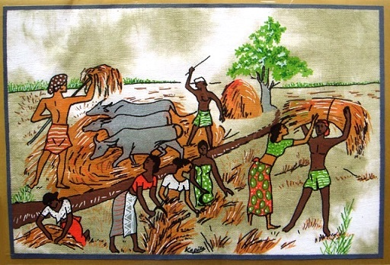
Module 1 - Agriculture

Slide 9
Contd…,
Session 1
SLO 1 – Ancient Agriculture
SLO 2 - Locating the early agricultural settlements in the Indian map
Session 2
SLO 1 – Crop cultivation - Community based Environment
SLO 2– Crop cultivation - Community based Environment
Session 3
SLO 1 –Water management - irrigation methods
SLO 2 –A region based study
natural water resources and aquifers
types of irrigation

Slide 10
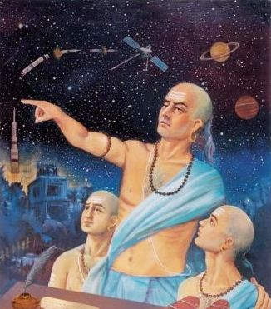
Module 2 – Astronomy & Mathematics

Slide 11
Contd…,
Session 1
SLO1 - Concepts of time and space - Knowledge of the Universe
SLO2 - Quiz
Session 2
SLO1 - Great astronomers and mathematicians of ancient India
SLO2 - contributions of Astronomers and Mathematicians
Session 3
SLO1- The planetary system and Indian Astrology: Basic Facts
SLO2 - Discussion on a few sample birth charts and predictions made

Slide 12

Module 3 - Medicine
12

Slide 13
Contd…,
Session 1
SLO1 - Introduction to the school of Ayurveda, Siddha and Naturopathy
SLO2 - Compare and Contrast the popular beliefs, myths and truths about medications
Session 2
SLO1 - Holistic Therapeutic Approach – Natural elements,
SLO2 - Case Studies
Session 3
SLO1 - Yoga and its Universal Appeal
SLO2 - Discussions on worldwide popularity of Yoga and meditation

Slide 14
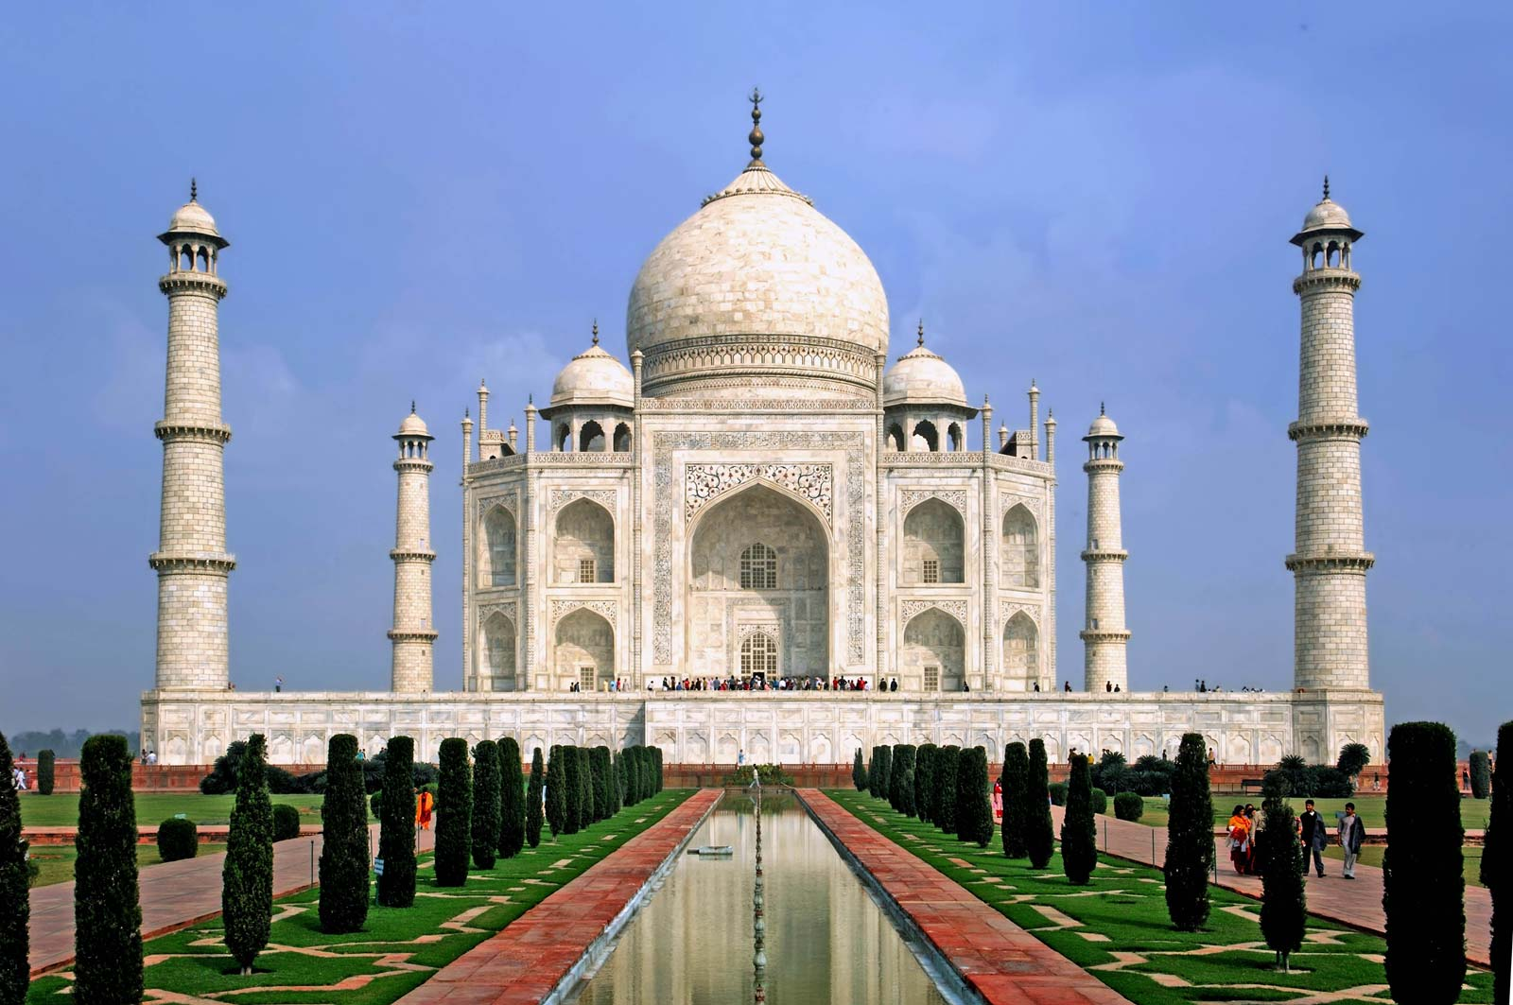
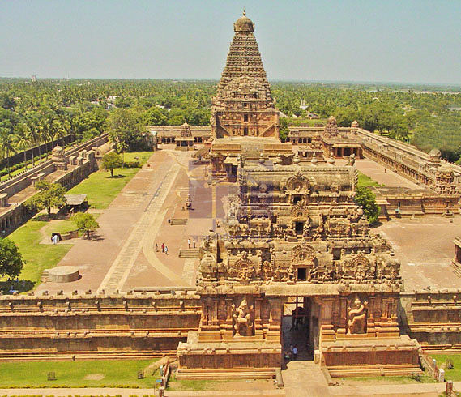
Module - 4
Engineering & Technology

Slide 15
Contd…,
Session 1
SLO1 – Architecture - Temples, forts, palaces, houses and town planning
SLO2 - Group Discussion
Session 2
SLO1 - Metallurgy – Coins, Traditional Indian Metal Carvings
SLO2 - Discussions on historical periods - architectural influences
Session 3
SLO1 - Textile technology
SLO 2 - Comparing the Temple Architecture of North and Southern Indian States

Slide 16
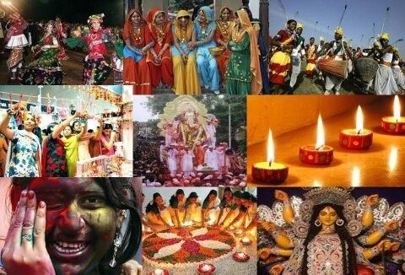
Module 5 – Customs, Sayings and Life Truths

Slide 17
Contd…,
Session 1
SLO 1 - Regional myths, beliefs,,and cultural practices
SLO 2 – Collect the idioms, proverbs in vernacular medium connected
Session 2
SLO1 - Traditional Foods of India in accordance with the climate & availability of the resources
SLO2 - Collecting old sayings in specific regions of India
Session 3
SLO1 - Translating Regional sayings into English
SLO2 - Traditional sayings - Hygiene and practices

Slide 18
Assessment
CLA T 1 – 20
CLA T 2 – 20
CLA T 3 – 20
CLA T4 – 40

Slide 19
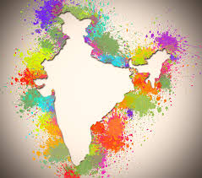
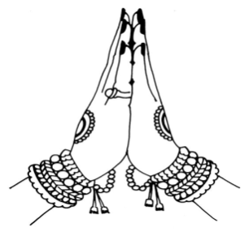
Thank you
18

Slide 20


